Slide 1
IBM x Columbia
Weekly Meeting
IBM x Columbia Core Team
11/14/2025

Slide 2
AGENDA
1
2
3
4
5
IBM x Columbia
11 / 2025
Why we're here today
Overview
Timeline
Team Check-in
Questions Classification
Next Step

Slide 3
Overview
This weekly meeting will be focusing on establishing a clear roadmap and reviewing initial progress for the IBM x Columbia project. Including the timeline, team check-in, and some Q&A at the end.

Slide 4
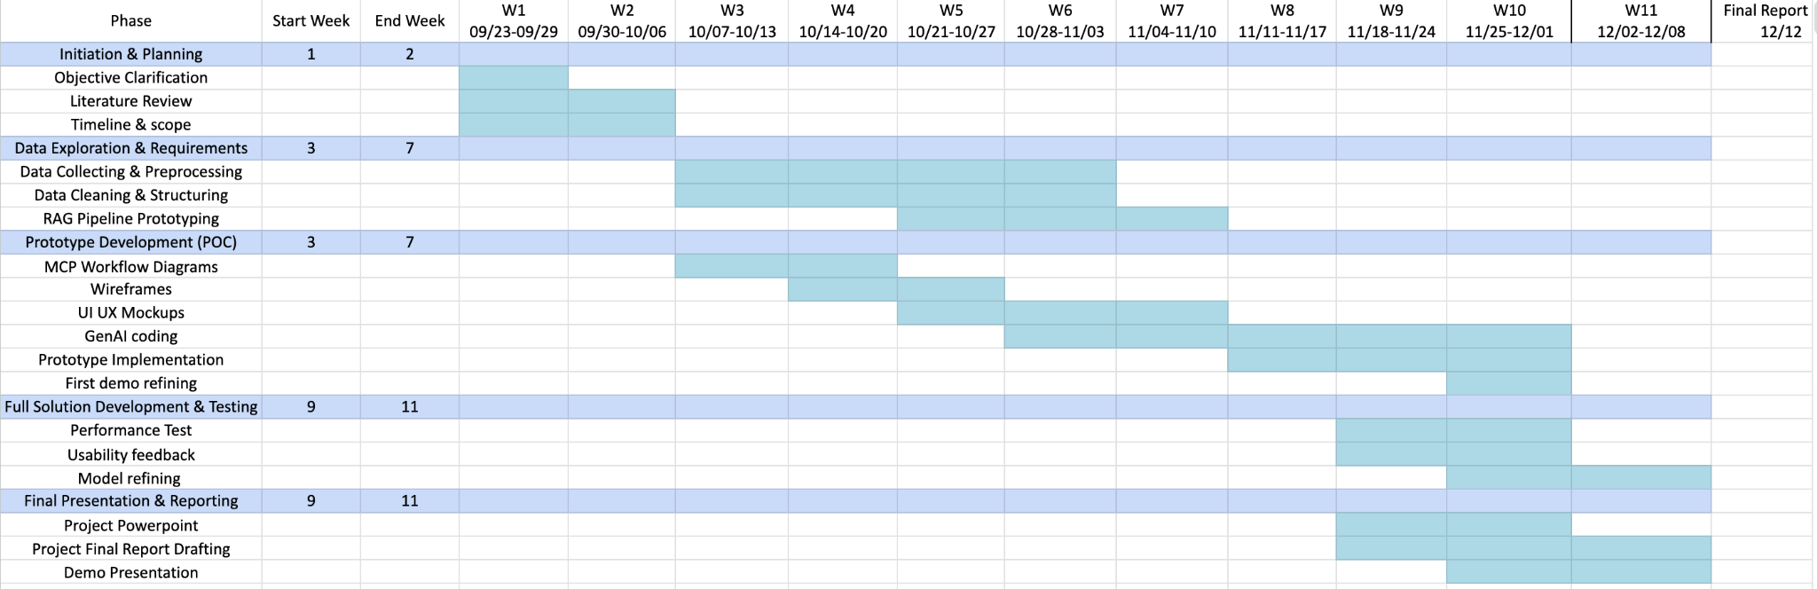
Timeline

Slide 5
Team Check-in
Data & Knowledge Engineering Team
Generative AI & Model Development Team
User Experience & Application Development Team
Evaluation & Compliance Team

Slide 6
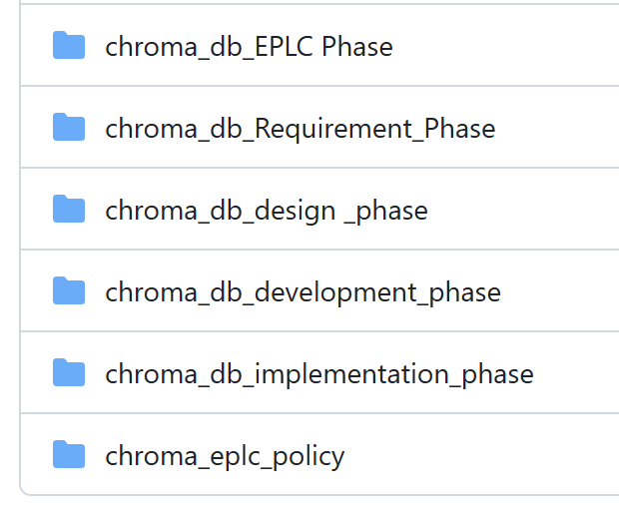
Data & Knowledge Engineering Team
Built Vector Database for each phase✅(uploaded to Repo)
Word/PDF Templates
↓
Text Extraction + Cleaning (done)
↓
Standardized JSON (done)
↓
Chunk & Flatten (done)
↓
Embedding Model (Hugging Face)
↓
Vector Database (Chroma / FAISS / Pinecone)
↓
RAG Retrieval (GenAI Team)

Slide 7
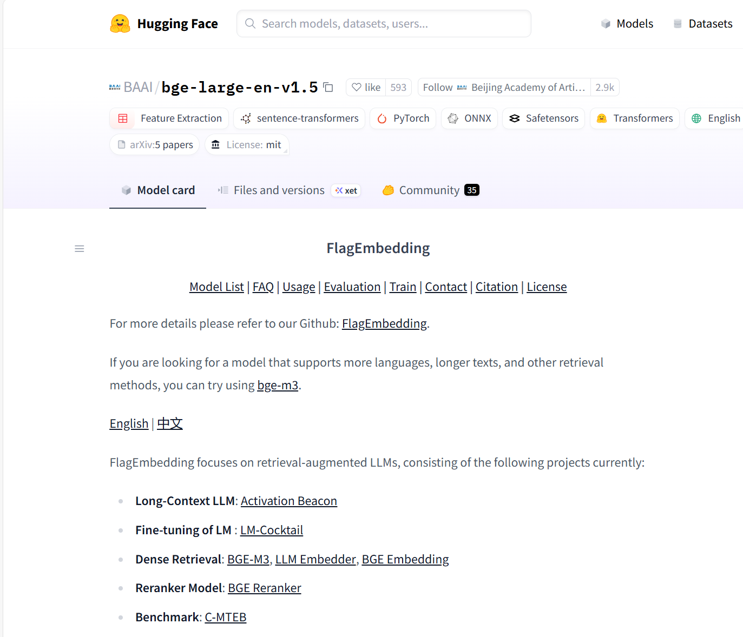
Data & Knowledge Engineering Team
Chunk similarity stable in the 0.70–0.85 optimal range
Higher accuracy in retrieved EPLC/CDC sections
Faster indexing & retrieval than ultra-large models

Slide 8
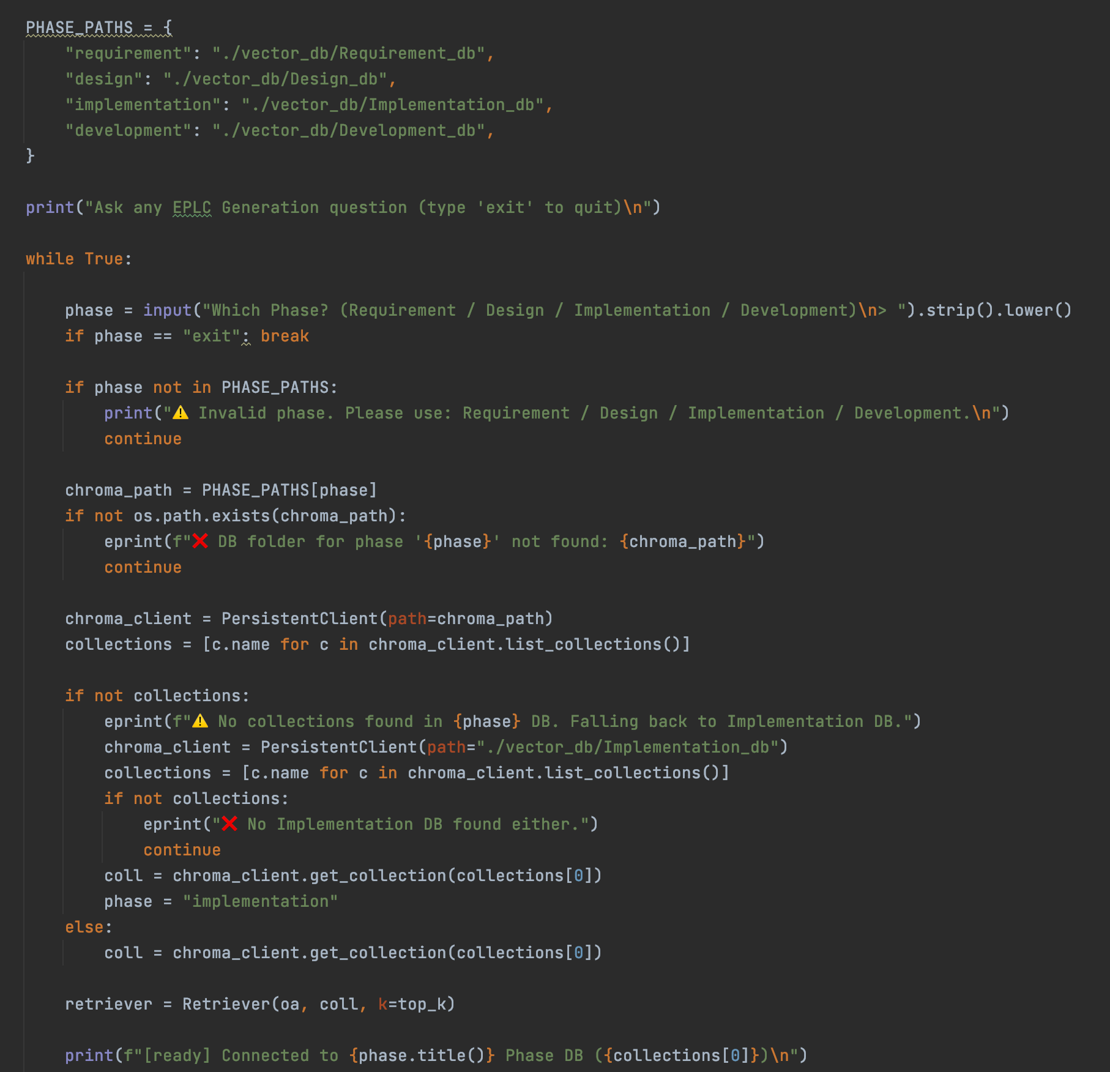
GenAI & Model Development
Content Generation
User Input (Phase + Template + Section + Details)
│
Phase Routing (select correct vector DB)
│
Embedding (1024-dim)
│
Vector Retrieval (Chroma)
│
Context Assembly
│
LLM Generation (produce paste-ready section)
│
User Paste into EPLC template

Slide 9
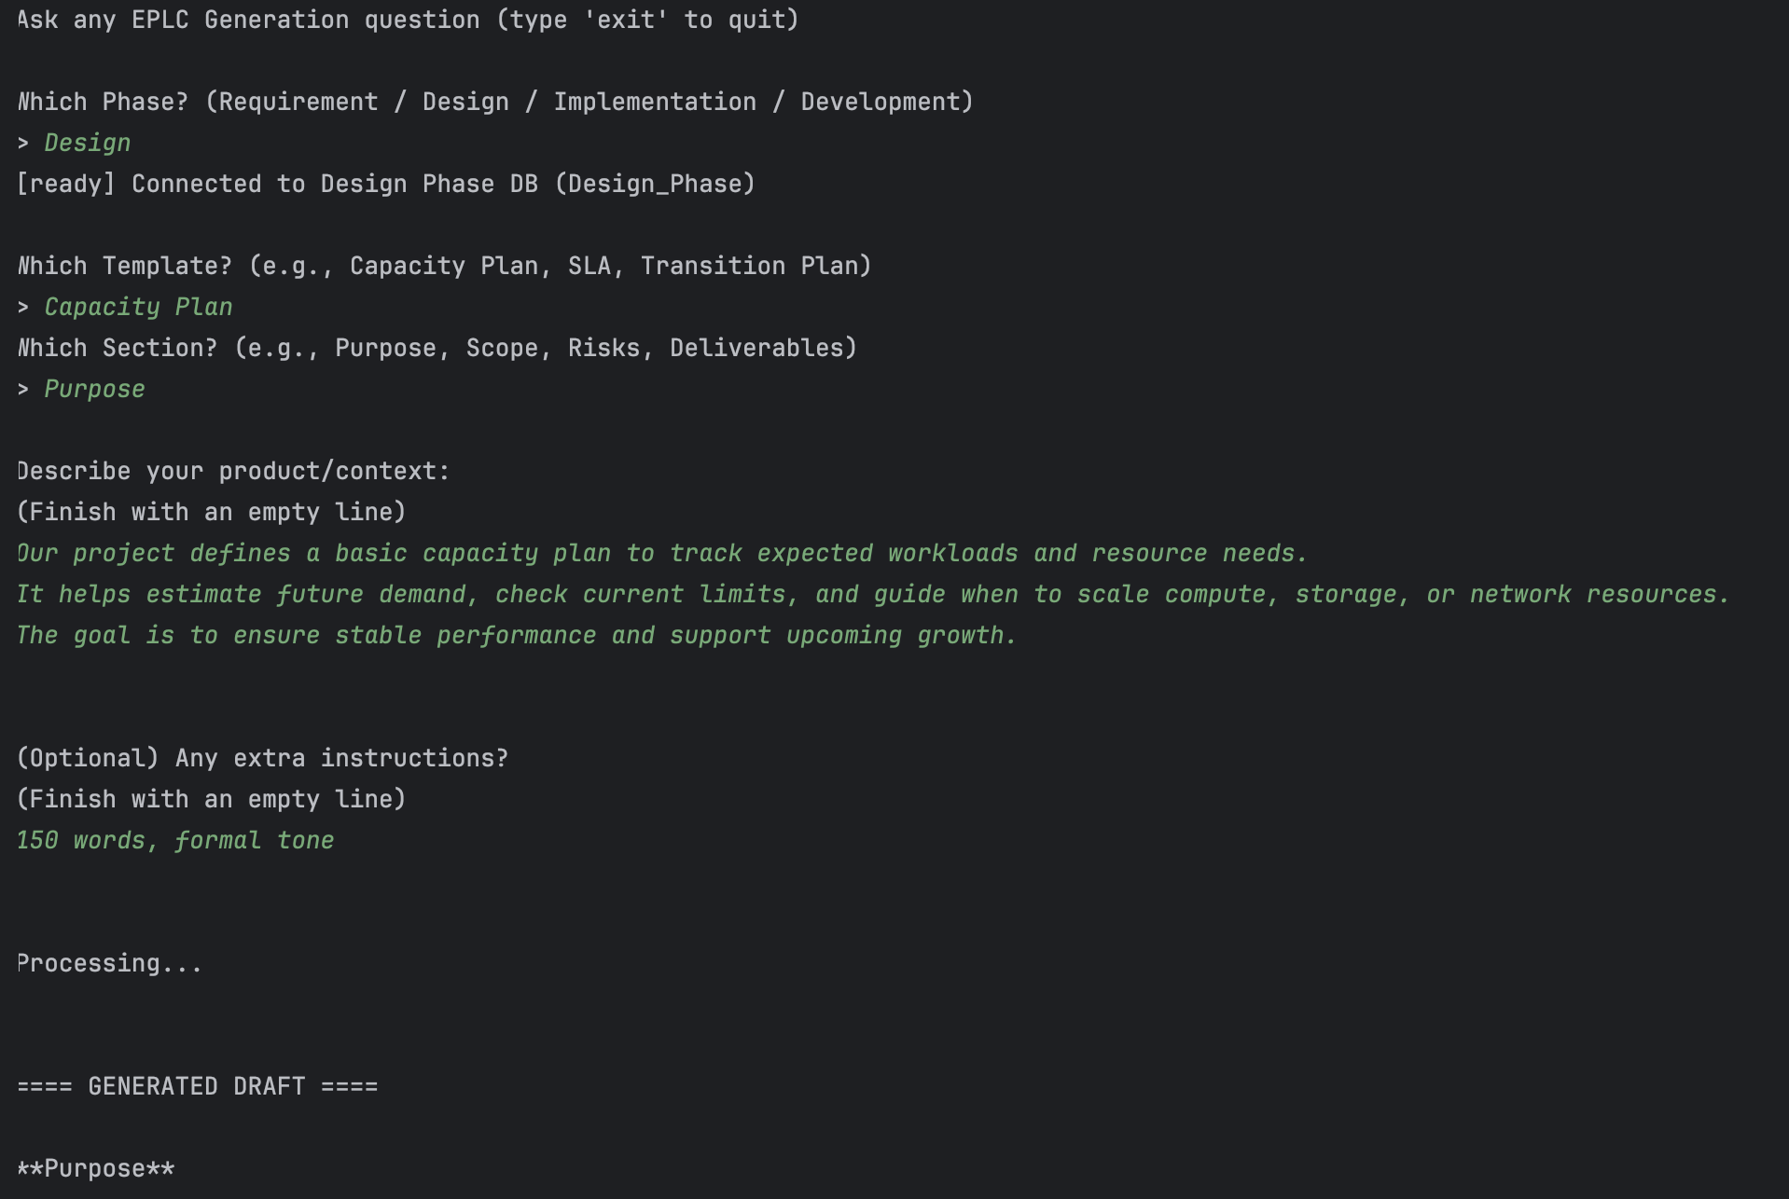
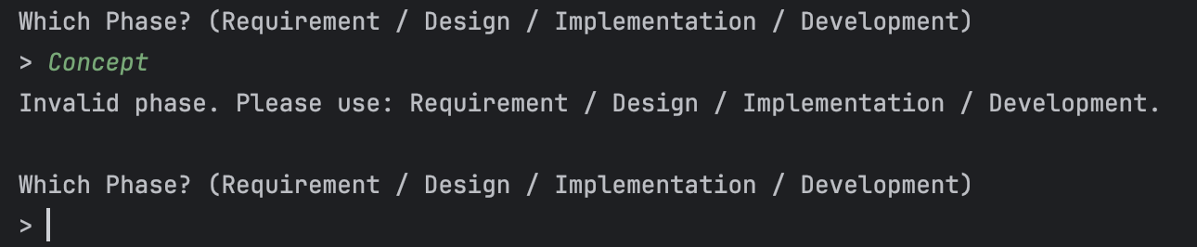
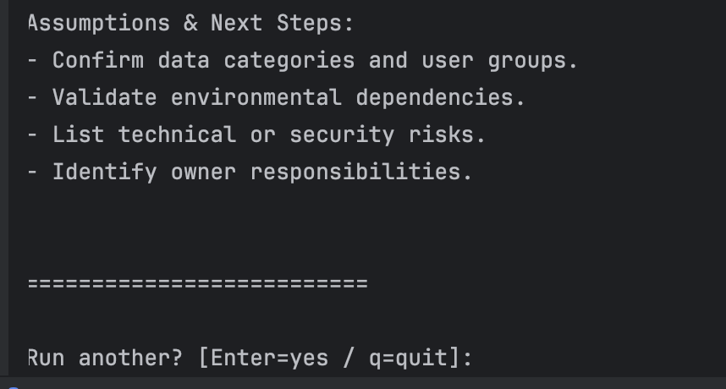
GenAI & Model Development
The purpose of this Capacity Plan is to establish a comprehensive framework for assessing and managing the resource requirements necessary to support the anticipated workloads throughout the project lifecycle. This plan aims to provide a systematic approach to estimating future demand for compute, storage, and network resources, ensuring that the infrastructure can accommodate growth while maintaining optimal performance levels. By evaluating current resource limits and forecasting potential increases in workload, the Capacity Plan serves as a critical tool for identifying when to scale resources effectively. This proactive strategy is essential for mitigating risks associated with resource shortages and performance degradation, thereby facilitating seamless operations and enhancing user experience. Ultimately, the Capacity Plan is designed to align resource allocation with business objectives, ensuring that the project can adapt to evolving demands while maintaining stability and efficiency in service delivery.

Slide 10
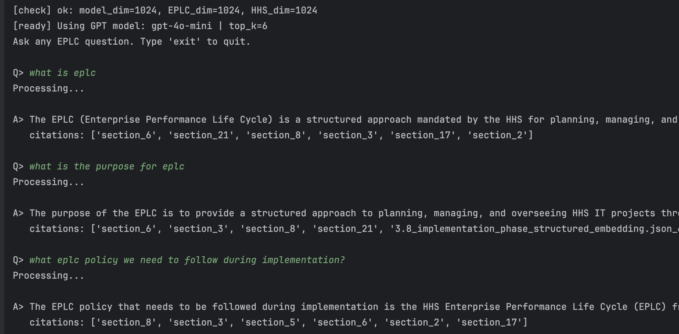
GenAI & Model Development
Q&A Updates
A: The EPLC (Enterprise Performance Life Cycle) is a structured approach mandated by the HHS for planning, managing, and overseeing IT projects throughout their entire life cycle. It incorporates project management practices, emphasizes incremental and iterative development, and ensures accountability and transparency in managing HHS IT projects. The EPLC framework aims to improve project management processes and the quality of IT products.
A: The purpose of the EPLC is to provide a structured approach to planning, managing, and overseeing HHS IT projects throughout their entire life cycle. It aims to ensure the quality of HHS IT products through improved project management processes, accountability, and compliance with established requirements and standards.
A: The EPLC policy that needs to be followed during implementation is the HHS Enterprise Performance Life Cycle (EPLC) framework for information technology (IT) project management at HHS. This policy outlines the structured approach to planning, managing, and overseeing HHS IT projects throughout their entire life cycle.

Slide 11
User Experience & Application Development Team

Slide 12
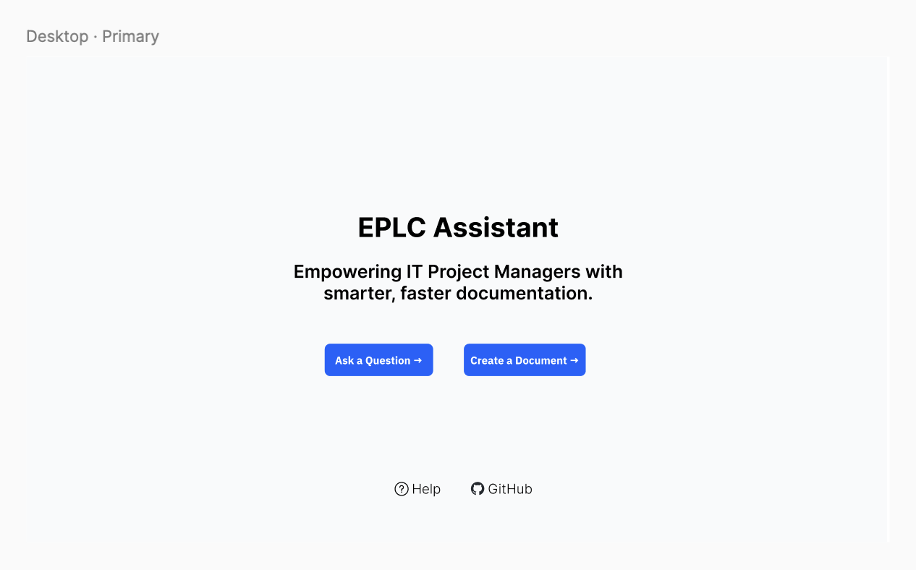

Slide 13
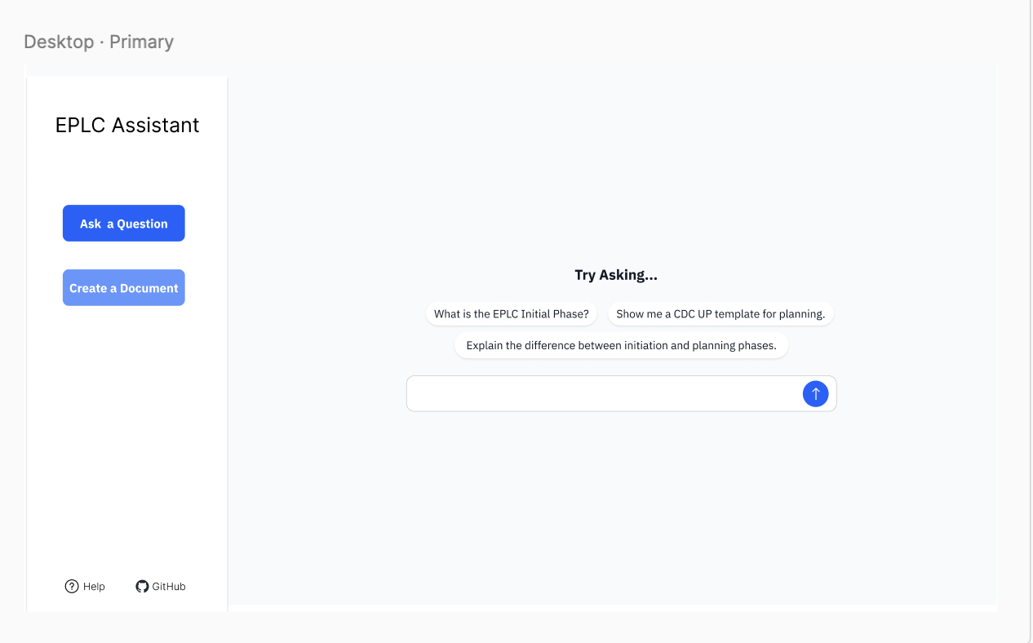

Slide 14
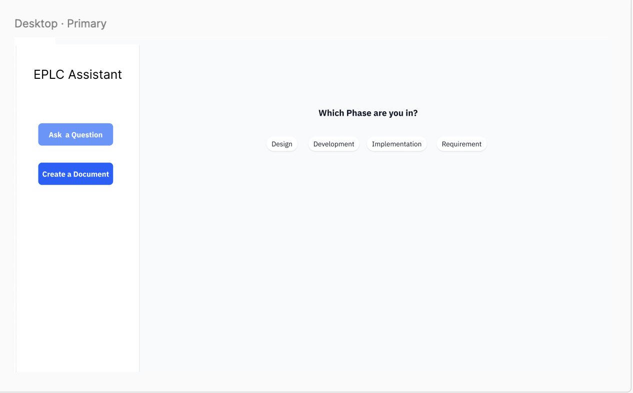

Slide 15
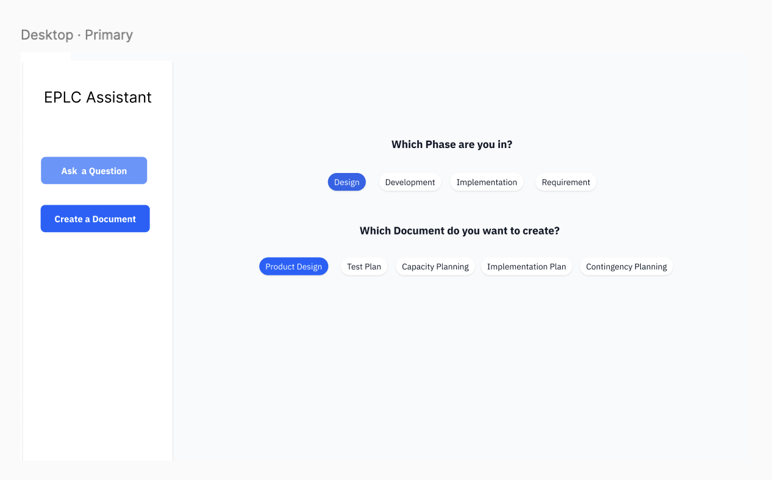

Slide 16
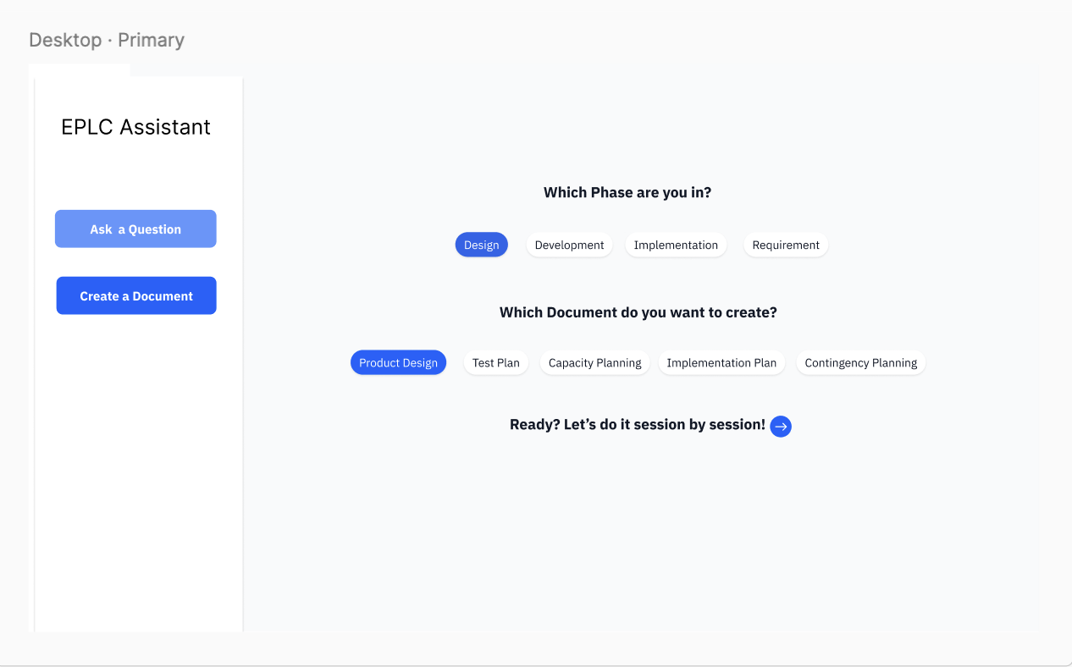

Slide 17
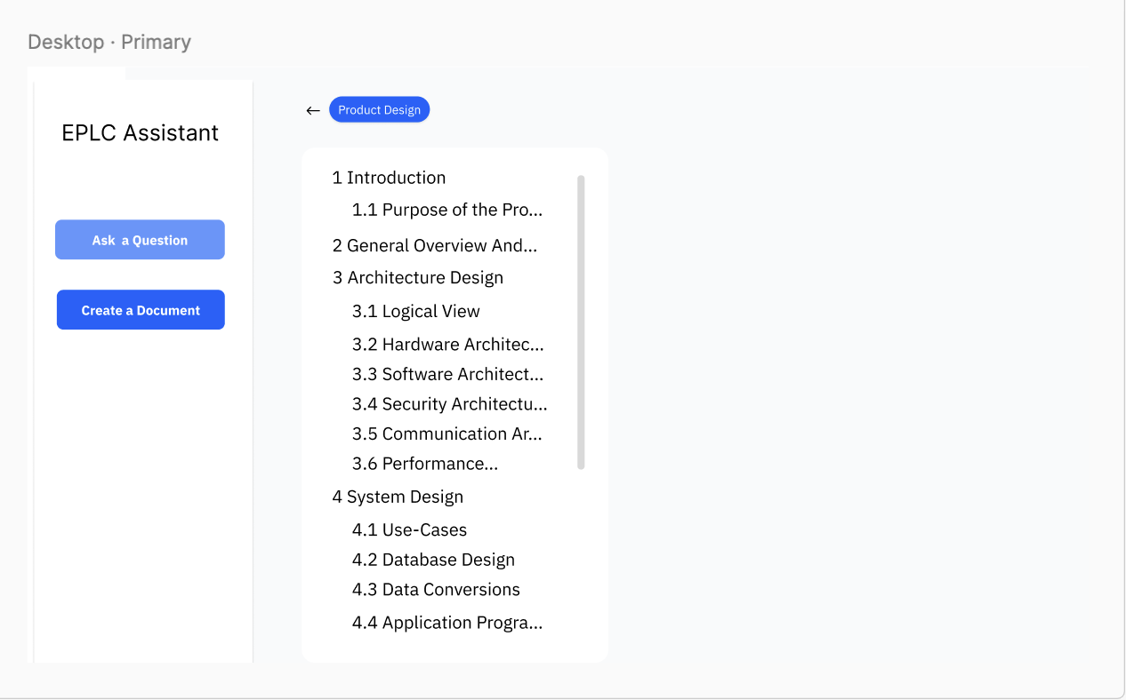

Slide 18
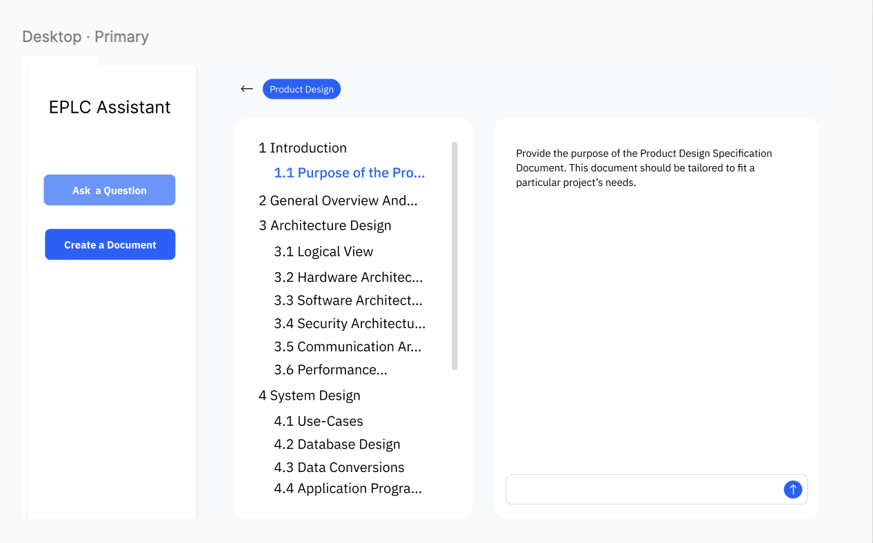

Slide 19
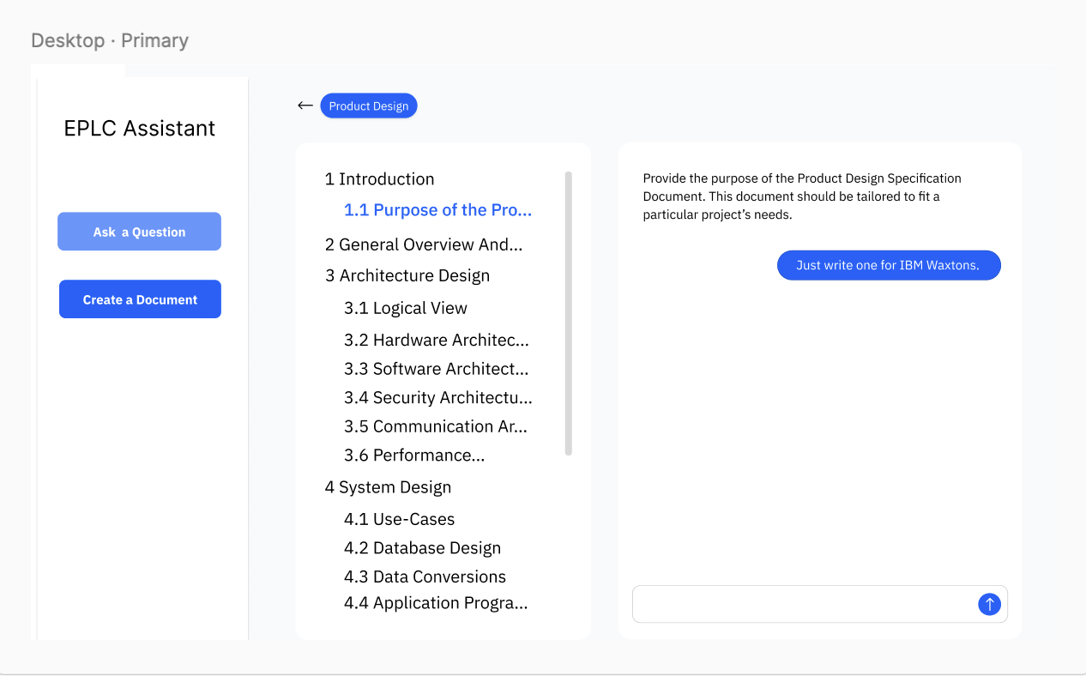

Slide 20
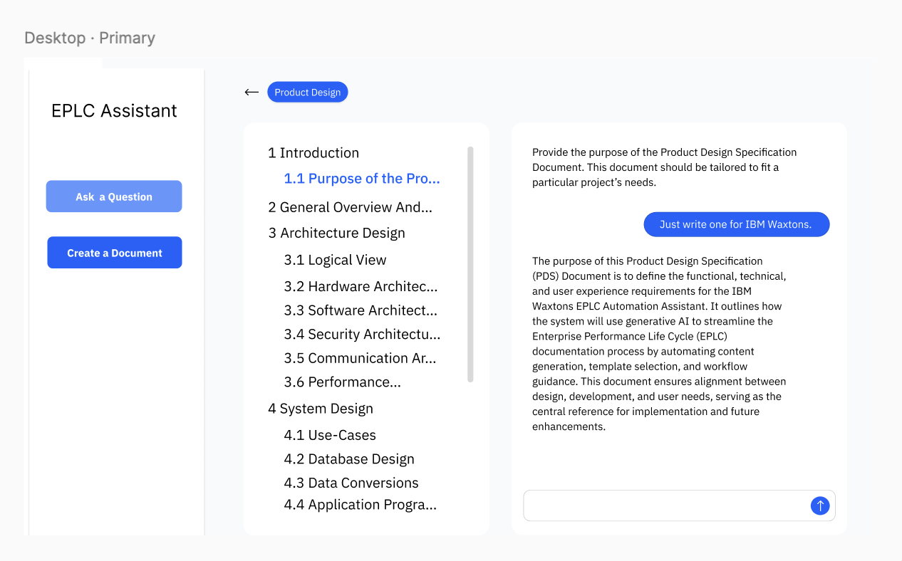

Slide 21
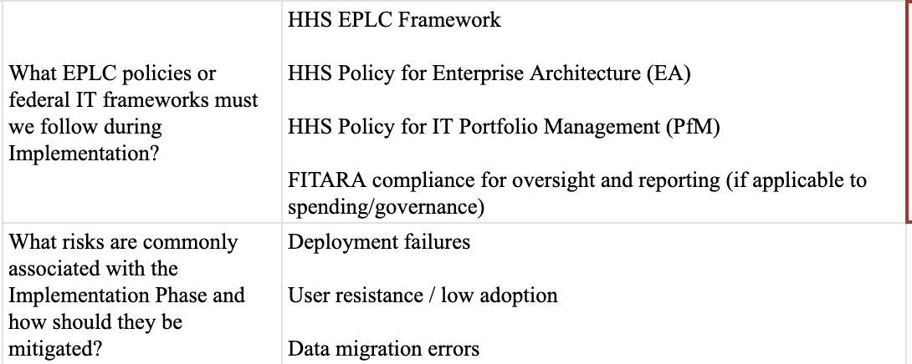
Evaluation & Compliance Team
Q：We are encountering a data gap when drafting testing question list: we have the EPLC templates (the questions), but not the project-specific source content (the answers) for WatsonX/HHS.
What is the preferred source for these project details, mock-up or actual documentation?

Slide 22
Questions

Slide 23

NEXT
STEPS
Keep up with the timeline, communicate with the sub-team for better support. Diving into the topics we’ve touched on today to deepen our understanding on the project, and starting the data preparation procedure.

Slide 24
THANK
YOU!
IBM x Columbia
11 / 2025
Columbia Practicum Core Team

